Slide 1
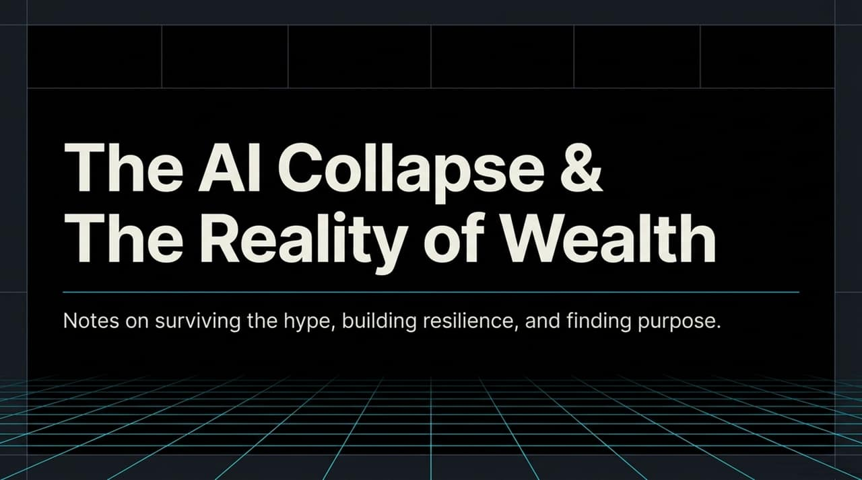
Notes:
https://www.youtube.com/watch?v=NdU6UdUKaYc
Opening: "Welcome, everyone. Today we are stepping past the noise of Silicon Valley and examining the stark divergence between AI hype and economic reality."
The Core Premise: "Silicon Valley is actively selling us AI fear—framing artificial intelligence as an unstoppable, job-destroying meteor. But when you examine macroeconomics, market dynamics, and human psychology, a very different picture emerges."
Two Parallel Stories: "This talk covers two interlinked themes: first, why the financial bet on AI is built on a shaky bubble that is rapidly shifting perceptions of tech leaders; and second, how individuals can navigate this landscape by focusing on real human skills, resilience, and personal wealth building."
Transition Cue: "Let's begin by looking at how public perception of both the US tech apparatus and AI itself has deteriorated globally."

Slide 2
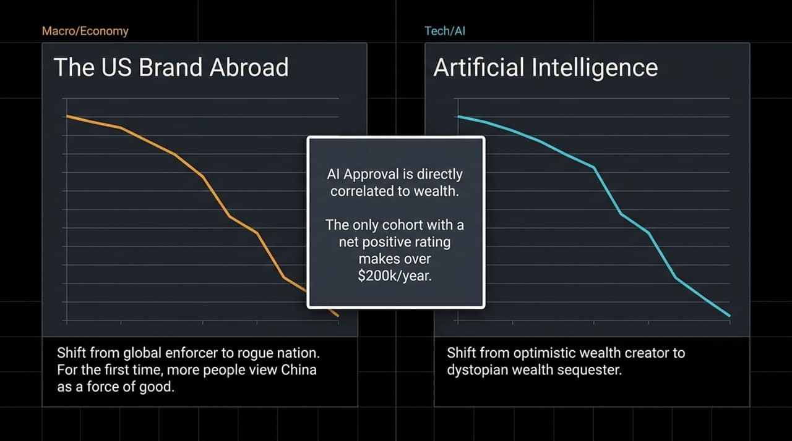
Notes:
Brand Destruction: "As Scott Galloway notes, the last 18–24 months have seen unprecedented destruction of two major global brands: the US brand abroad and the AI/Big Tech brand."
Shift from Enforcer to Rogue Nation: "Geopolitically, international sentiment has turned. For the first time in modern polling, more global citizens in key regions view alternative global powers like China as a force for stability compared to a erratic US foreign stance."
Class Divide in AI Sentiment: "Notice the income stat on this slide: AI approval is directly tied to wealth. The only demographic cohort with a net positive opinion of AI comprises households making over $200,000 a year."
Why the Middle Class Distrusts AI: "If you are an executive or wealthy investor, AI represents margin expansion and labor cost reduction. If you are a middle-income worker, AI represents job insecurity, algorithmic surveillance, and automated displacement."
Transition Cue: "This class tension brings us to the core mechanism driving Silicon Valley's narrative: why tech leaders are intentionally hyping apocalyptic AI scenarios."

Slide 3
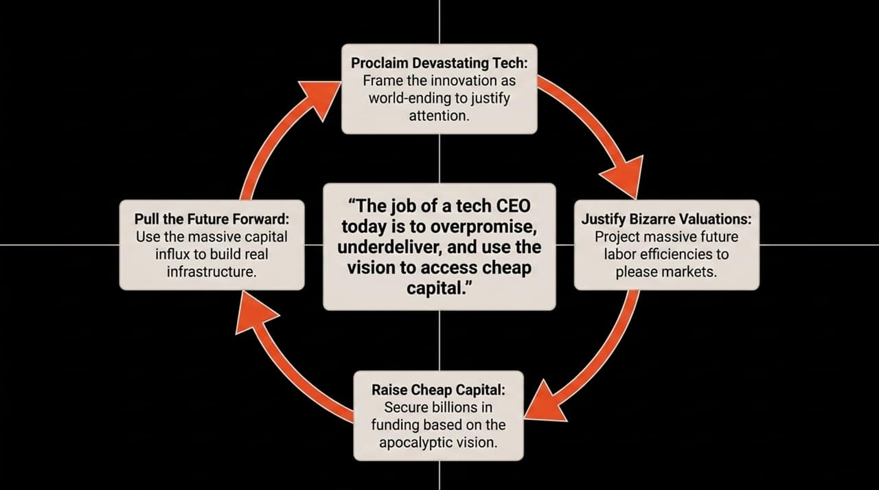
Notes:
The Tech CEO Playbook: "Look at the quote at the center: 'The job of a tech CEO today is to overpromise, underdeliver, and use the vision to access cheap capital.'"
Catastrophizing as a Fundraising Tactic: "When Elon Musk declares that 'AI and robots will replace all jobs,' or Sam Altman claims data centers will soon possess more intellectual capacity than all humanity, this isn't purely altruistic warning. It is 'jazz hands' marketing."
The 4-Step Capital Engine:
Proclaim Devastating Capability: Frame your software as world-altering or apocalyptic to capture 100% of global mindshare.
Raise Cheap Capital: Secure billions in sovereign wealth and venture investment at astronomical valuations based on that vision.
Justify Bizarre Valuations: Claim that future enterprise labor savings will yield multi-trillion-dollar returns.
Pull the Future Forward: Use the massive capital influx to buy physical infrastructure—chips, power grids, and data centers.
The Revenue Wall: "To justify current AI company valuations, enterprise software buyers need to generate over a trillion dollars in new incremental revenue from AI products over the next 5 years. We simply aren't seeing that software monetization materialize yet."
Transition Cue: "So, if tech leaders claim AI is wiping out jobs today, what does the actual macroeconomic data say?"

Slide 4
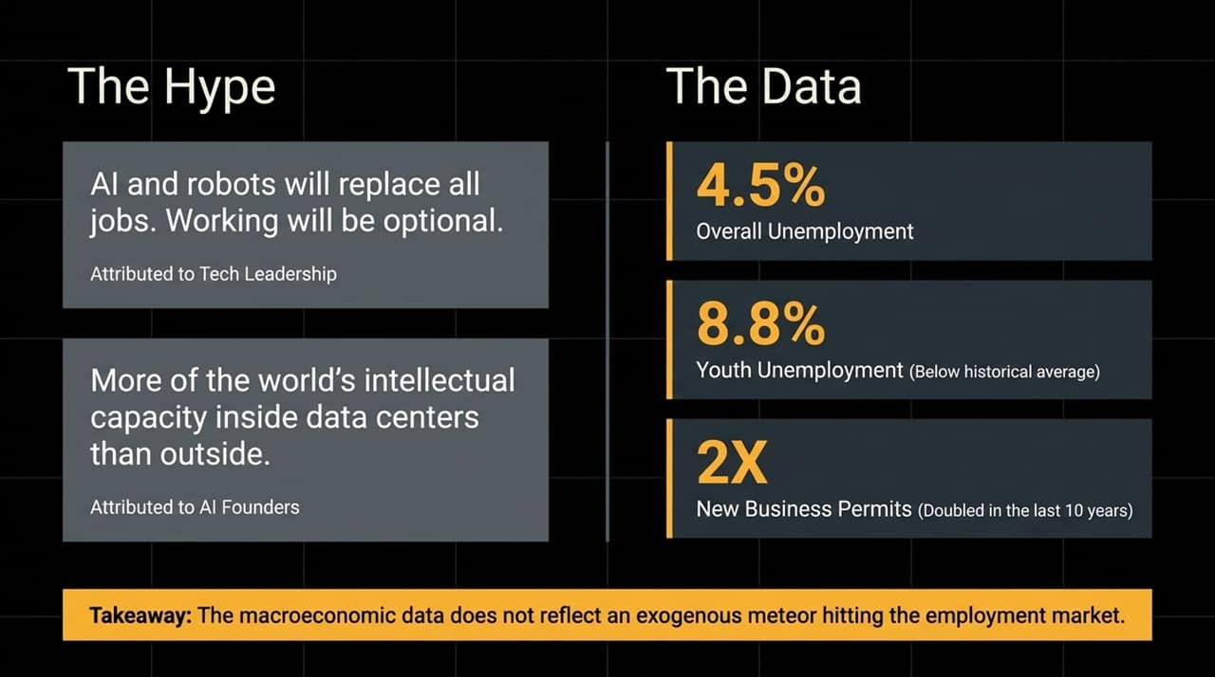
Notes:
Fact vs. Narrative: "If you listened only to technology news, you would assume a technological asteroid has already hit the labor market. But look at the actual hard data."
Key Economic Indicators:
4.5% Unemployment: Broadly holding near historic lows.
8.8% Youth Unemployment: Contrary to headlines about Gen Z employment doom, youth unemployment remains comfortably below long-term historical averages.
2X New Business Permits: Entrepreneurship and small business creation have doubled over the past decade.
The Core Takeaway: "The macroeconomic data does not reflect an exogenous meteor striking employment. The apocalyptic narrative is a narrative artifact designed to justify tech multiples, not an empirical economic reality."
Transition Cue: "However, just because there isn't an apocalypse today doesn't mean tech valuations are safe. Let's walk through the crash scenario: Executive Terminal Noir."

Slide 5
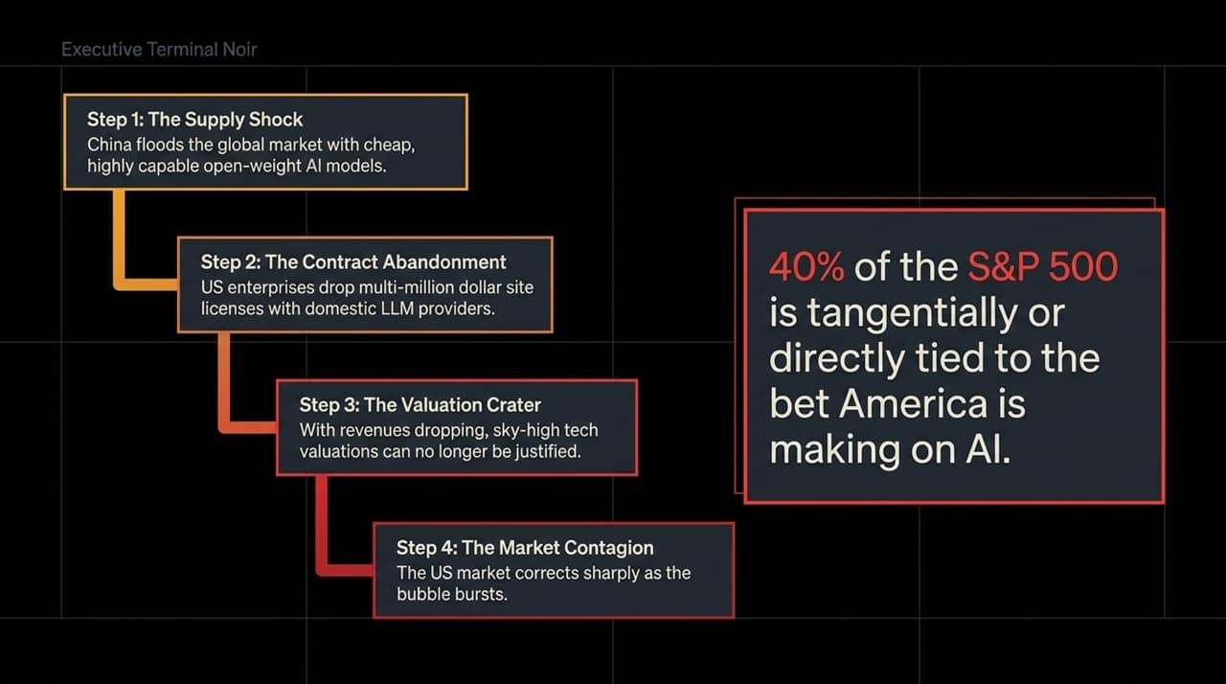
Notes:
The Vulnerability of the S&P 500: "Currently, 40% of the value of the S&P 500 is directly or tangentially tied to the massive financial bet America is making on AI dominance."
The 4-Step Contagion Cascade:
Step 1: The Supply Shock: Low-cost or open-weight models (often emerging from Chinese research labs or open-source communities) flood the market with capabilities matching 90%+ of proprietary top-tier models at 1/10th the price.
Step 2: Contract Abandonment: Enterprise CFOs look at their $50M/year proprietary LLM site licenses, realize they can host open-source models locally for a fraction of the cost, and cancel major subscriptions.
Step 3: The Valuation Crater: Proprietary AI companies see ARR (Annual Recurring Revenue) plateau or drop. Sky-high revenue multiples (e.g., 90x to 100x revenues) collapse overnight to historical tech averages (10x).
Step 4: Market Contagion: Because the broader index is hyper-concentrated in AI infrastructure giants, the bursting bubble triggers a sharp broader market correction.
Transition Cue: "Why is AI prone to this crash? It comes down to economic paradigms: Divergent vs. Convergent technologies."

Slide 6
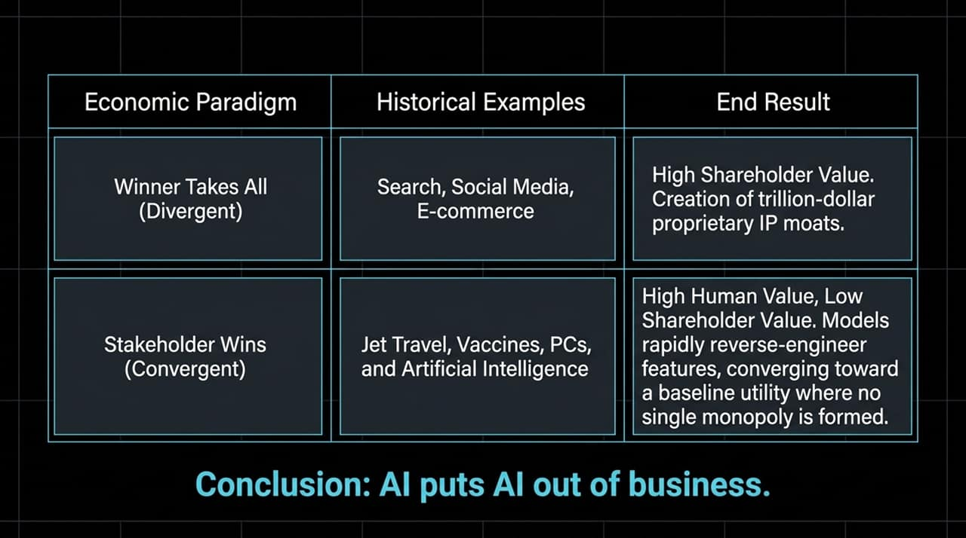
Notes:
Divergent (Winner Takes All): "Technologies like Web Search or Social Networks benefit from network effects. Google gets better with more searches; Facebook gets stronger with more users. This creates massive shareholder value and permanent, multi-trillion-dollar moats."
Convergent (Stakeholder Wins): "Technologies like jet engines, vaccines, personal computers, and AI are convergent. Competitors quickly reverse-engineer capabilities and push features toward baseline utility. High human value, low individual shareholder moat."
Commoditization Paradox: "Because AI excels at coding, research, and model optimization, AI models accelerate the development of cheaper rival AI models. In short: AI puts AI out of business. Margins compress to the cost of compute."
Transition Cue: "Now, let's turn from macroeconomics to individual careers: how is AI actually reshaping work?"

Slide 7
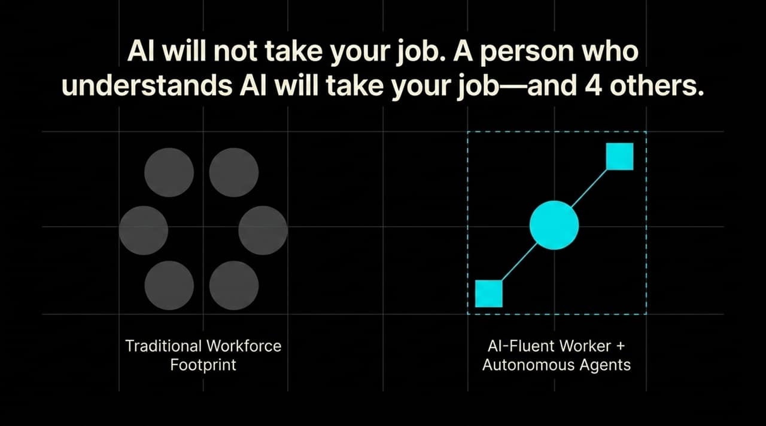
Notes:
Reframing Displacement: "Forget the headline that robots are coming for every human job tomorrow. The real dynamic is internal workplace consolidation."
1 Person + 4 Agents: "An employee fluent in AI tools—who knows how to orchestrate prompt workflows, agentic automation, and automated reporting—can perform the output previously requiring a 5-person team."
Organizational Impact: "Companies aren't shutting down; they are shrinking team sizes while expecting higher throughput. The competitive bar for mid-level white-collar roles has instantly shifted toward AI fluency."
Transition Cue: "This creates a striking structural reversal in where job demand is actually growing vs declining."

Slide 8
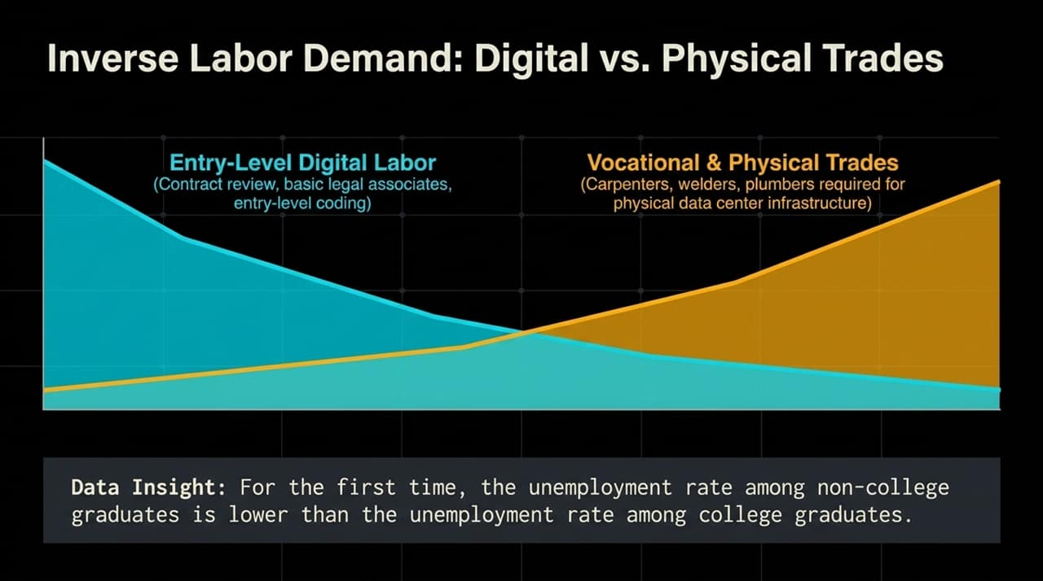
Notes:
The Great Inversion: "For 40 years, the advice to young people was simple: get a 4-year college degree, take an entry-level desk job in law, finance, or coding, and you will achieve job security. Today, that paradigm has flipped."
Digital Labor Compression: "Entry-level white-collar tasks—basic legal document review, junior coding, financial modeling, junior copywriting—are precisely the tasks AI automates first."
The Trade Boom: "Conversely, you cannot prompt an LLM to replace a broken data-center cooling pipe, weld high-voltage electrical conduit, or install physical fiber networks. The physical infrastructure backing AI requires immense skilled human trade labor."
Historical Stat Shift: "For the first time in modern economic history, the unemployment rate among non-college graduates is lower than the unemployment rate among college graduates."
Transition Cue: "To further put AI's near-term economic footprint in perspective, let's compare it to another booming technology sector."

Slide 9
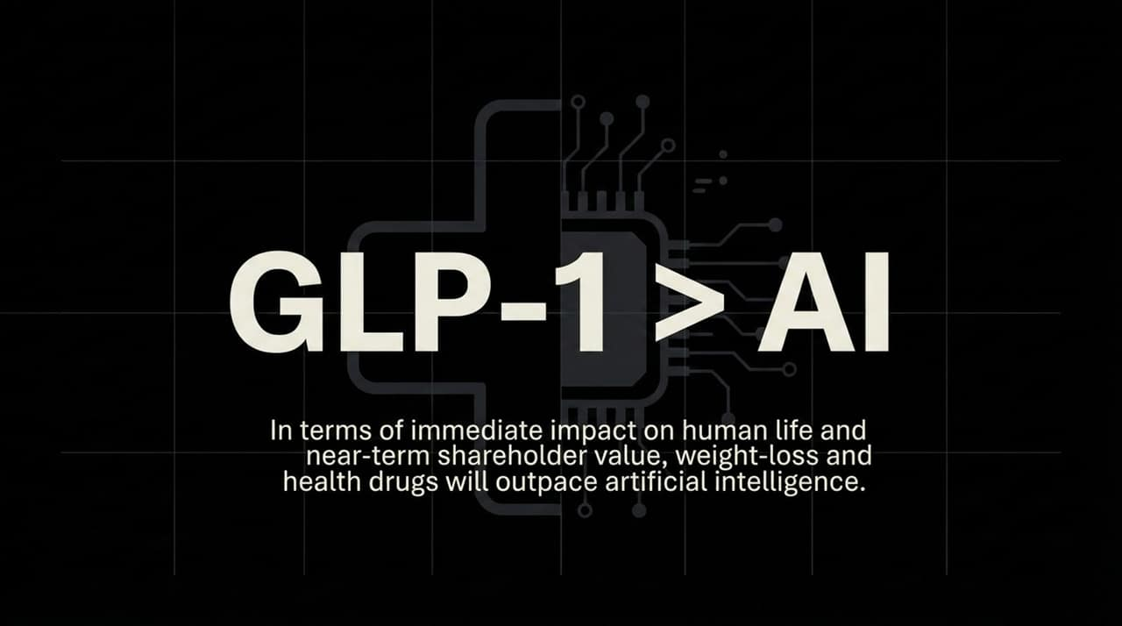
Notes:
Immediate Economic Impact: "While AI dominates media headlines and tech podcasts, GLP-1 weight-loss and metabolic drugs (like Ozempic and Wegovy) are having a far more immediate, quantifiable impact on consumer behavior, healthcare expenditures, and enterprise value."
Clear ROI: "Unlike AI software—where companies struggle to prove direct productivity gains—GLP-1 drugs deliver unambiguous, immediate human and economic outcomes: reduced obesity, lower cardiovascular risk, and shifting food consumption patterns."
Investor Perspective: "In terms of near-term shareholder value and real-world societal behavioral shifts, healthcare innovation is matching or outpacing AI."
Transition Cue: "Now, let's pivot to the deep human cost of our tech-saturated environment: the loneliness epidemic."

Slide 10
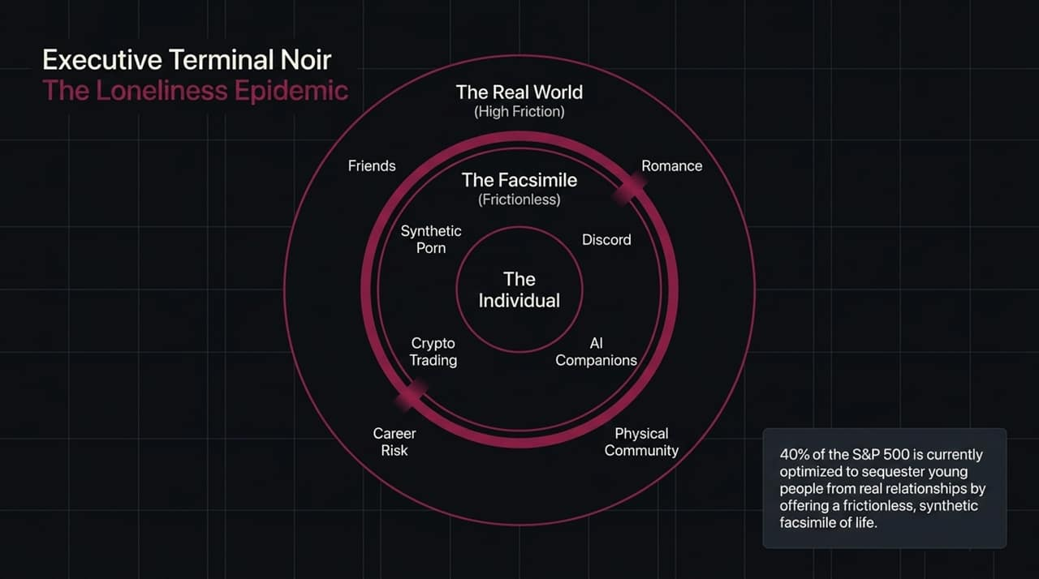
Notes:
The Monetization of Isolation: "Notice the statistic: 40% of S&P 500 market cap relies on algorithms designed to keep people glued to screens—sequestering them from physical human connection."
The Frictionless Facsimile: "Real relationships (romance, deep friendships, physical community) are high friction. They require vulnerability, physical presence, time, and potential rejection. Big Tech offers frictionless facsimiles: synthetic porn, AI companions, Discord threads, and crypto trading."
The Societal Trap: "By replacing authentic human interaction with artificial, dopamine-optimized substitutes, we are raising a generation stripped of social muscle memory."
Transition Cue: "How do we fight back against this digital atrophy? By building the single most critical skill for personal success: resilience to rejection."

Slide 11
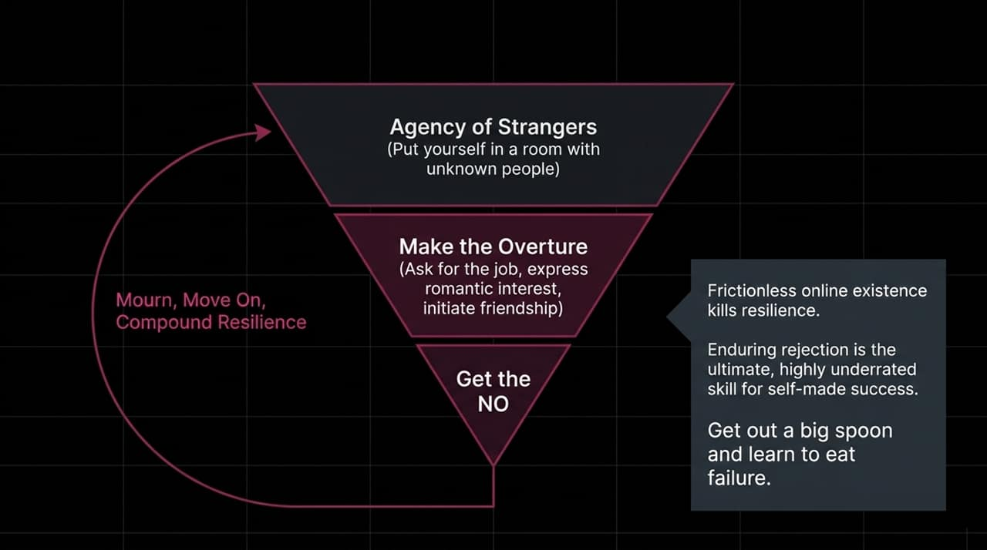
Notes:
The Atrophy of Risk-Taking: "A frictionless online existence destroys personal resilience. If you never ask someone out in person, never cold-call a customer, and never push yourself into a room of strangers, you never build tolerance for rejection."
The 4-Step Resilience Loop:
Agency of Strangers: Force yourself into physical rooms with people you do not know.
Make the Overture: Express romantic interest, pitch the business idea, or ask for the job.
Get the NO: Expect and normalize rejection.
Mourn, Move On, Compound Resilience: Realize that hearing 'no' doesn't break you—it strengthens your social threshold.
The Ultimate Edge: "In an automated world, the ability to endure rejection and punch above your weight is the rarest, most underrated human superpower."
Transition Cue: "When you build this resilience, you begin to understand why most people sell themselves short early in life."

Slide 12
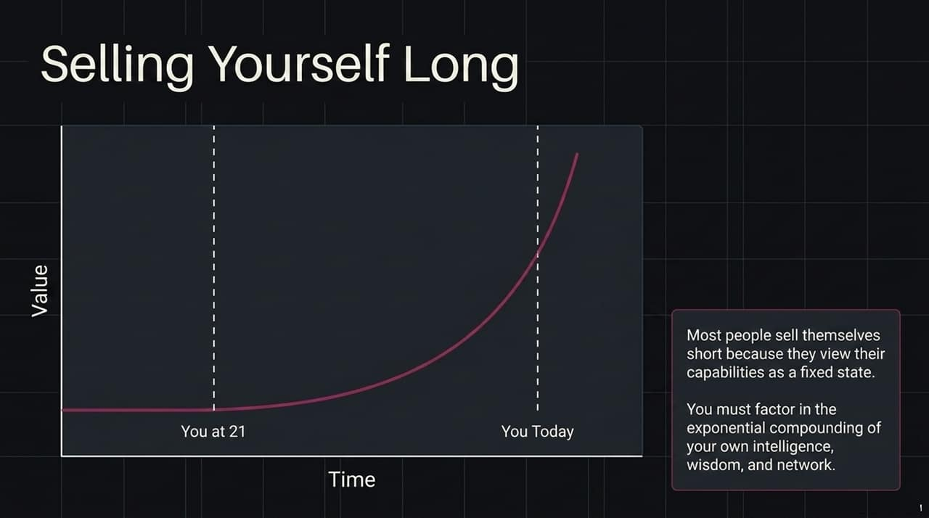
Notes:
The Fixed Mindset Mistake: "Most young professionals sell themselves short because they evaluate their worth based on a static view of their current 21-year-old skills."
Exponential Compounding: "Human capability compounds exponentially over time through wisdom, specialized experience, executive presence, and personal networks. You are not a static asset."
Long-Term Career Orientation: "Do not optimize for immediate comfort or early low-friction roles. Invest in high-learning, high-friction environments where your personal equity compounds."
Transition Cue: "Once you generate strong active income through compounding skills, how do you manage wealth in volatile markets?"

Slide 13
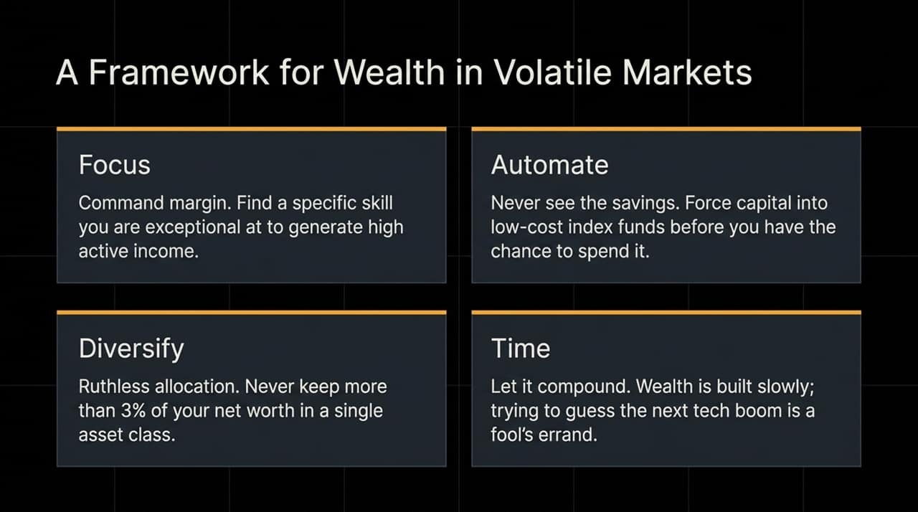
Notes:
Pillar 1: Focus: "Find a specific domain where you are in the top 10% and command strong active income margin. Trying to day-trade or hunt the next crypto/AI meme stock is a loser's game."
Pillar 2: Automate: "Never trust your own spending discipline. Set up automated sweep accounts that force savings directly into low-cost broad-market index funds before you ever see it."
Pillar 3: Diversify: "Enforce ruthless asset allocation. Never hold more than 3% to 5% of your net worth in any single stock or speculative asset class—no matter how much tech hype surrounds it."
Pillar 4: Time: "Wealth is built slowly through compound interest. Chasing speculative tech bubbles is trying to get rich quick; systematic compounding is how you actually stay rich."
Transition Cue: "Finally, wealth is useless without purpose. Let's look at the difference between Capitalist ROI and Purpose ROI."

Slide 14
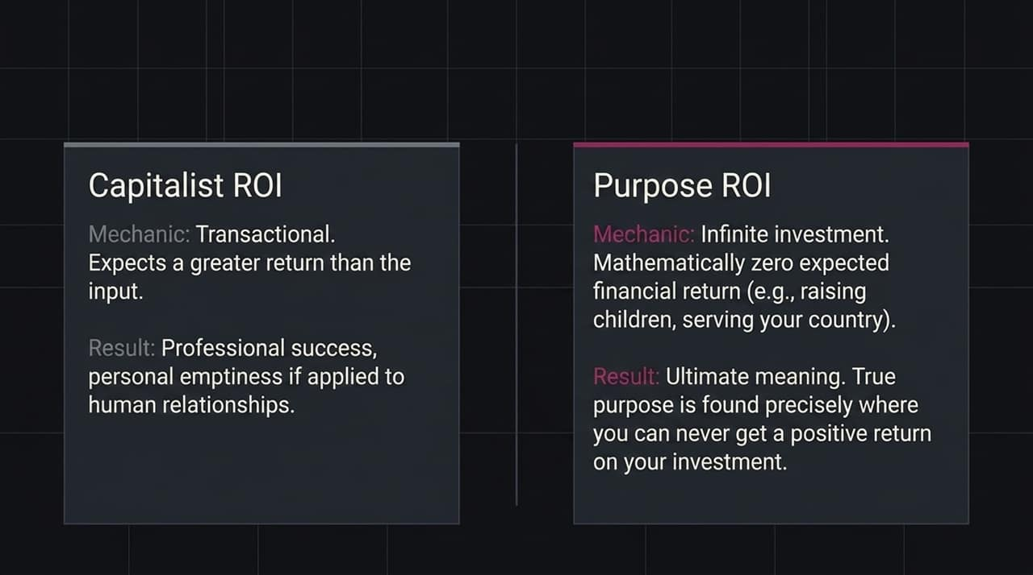
Notes:
The Limits of Transactional Thinking: "Capitalist ROI is transactional—you invest $1 expecting $2 back. It works in business, but applying it to personal relationships leads to emptiness."
Purpose ROI: "True life purpose is found in areas where the expected financial return is mathematically zero: raising children, serving your community, taking care of elderly parents, or mentoring others."
Finding Meaning: "Meaning isn't extracted from the market; it is created by making infinite non-transactional investments in human beings."
Transition Cue: "This brings us to Scott Galloway's central emotional insight on love, loss, and grief."

Slide 15

Notes:
The Emotional Currency: "In the video interview, Scott Galloway reflects on losing his mother and the profound grief that remains."
Grief as a Feature, Not a Bug: "Grief and anxiety are not systemic errors to be medicated away or avoided through frictionless digital living. They are the necessary receipts for deep human love."
Message to the Next Generation: "If you shield yourself from heartbreak, rejection, and loss by hiding behind AI companions and social media feeds, you also insulate yourself from profound joy and meaning."
Transition Cue: "Let's bring all these threads together in our final summary synthesis."

Slide 16
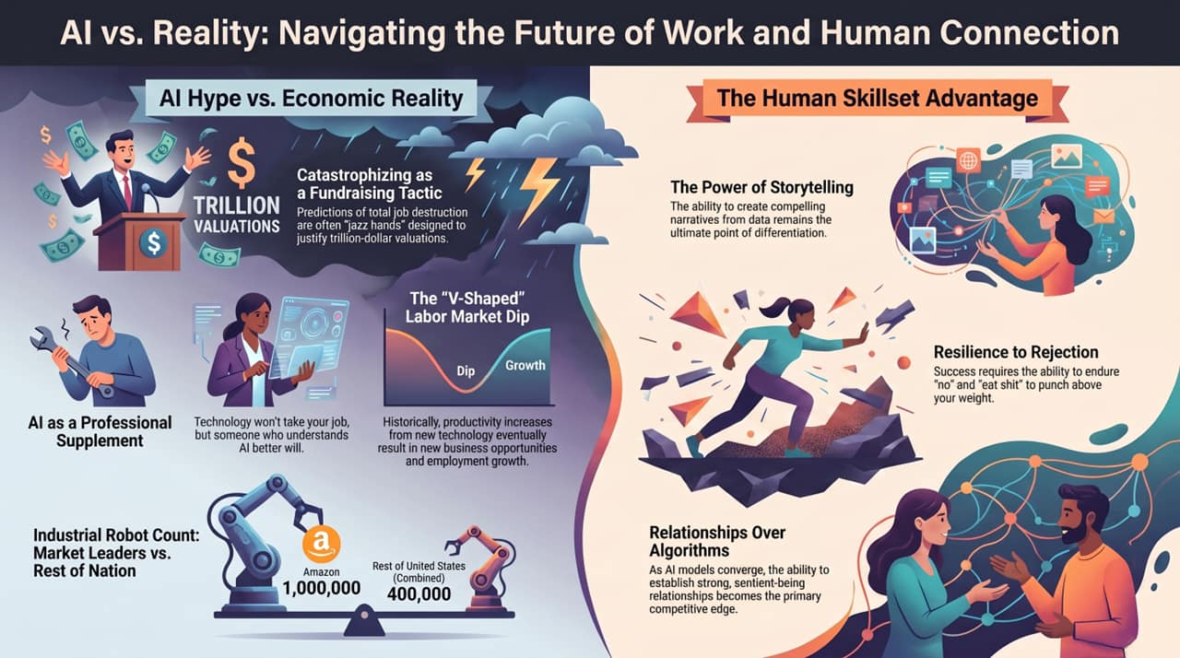
Notes:
Final Synthesis:
AI Hype vs. Reality: Catastrophizing is a fundraising mechanism. AI is an productivity supplement, not an instant replacement for human workforces. Labor markets will experience a V-shaped transition, but trade labor and physical infrastructure demand will remain resilient.
The Human Advantage: Software and algorithms are commoditizing toward zero margins. The ultimate enduring competitive advantages are purely human: Storytelling, Authentic Relationships, and Resilience to Rejection.
Closing: "Don't buy into the fear sold by Silicon Valley. Build your skills, invest in real human relationships, eat failure, and sell yourself long."
Q&A Opening: "Thank you. I look forward to your thoughts and questions."

